Slide 1
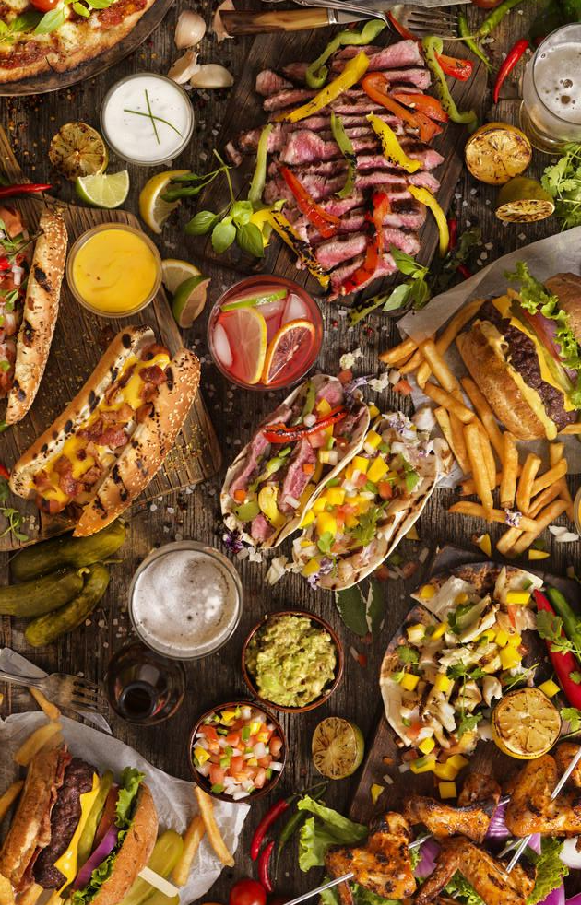
USDA FDC DATA ANALYSIS
AAYUSH SHARMA, REESE DALZELL, ROBERT VEDRA, DEVIN STOLTENBERG
UNITED STATES NAVAL ACADEMY

Slide 2


OUR GUIDING QUESTION
When the United States Department of Agriculture’s Food Data Central (USDA FDC) conducts nutrient analysis on foods, it can cost up to $50,000 per food they analyze. This is an unsustainable expenditure.
Which foods and nutrients should the USDA FDC focus their analysis on?
UNITED STATES NAVAL ACADEMY

Slide 3
The Data
Foundation Foods (FF)
Standard Reference (SR) Legacy
Data on individual samples of common foods with insights into variability. Examples include Kale and Potatoes.
Historic data on food components including nutrients derived from analyses, calculations, and published literature.
UNITED STATES NAVAL ACADEMY

Slide 4


ANALYSIS
We first did a broad analysis on the SR legacy and Foundational Food datasets.
Based on that product, we moved into a targeted analysis of the (foods/nutrients) that we found to vary outside the norm
UNITED STATES NAVAL ACADEMY

Slide 5
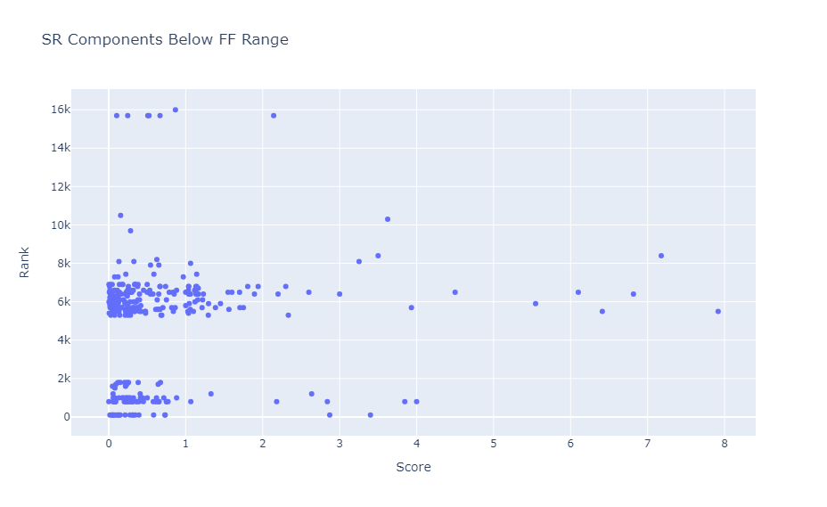
UNITED STATES NAVAL ACADEMY

Slide 6
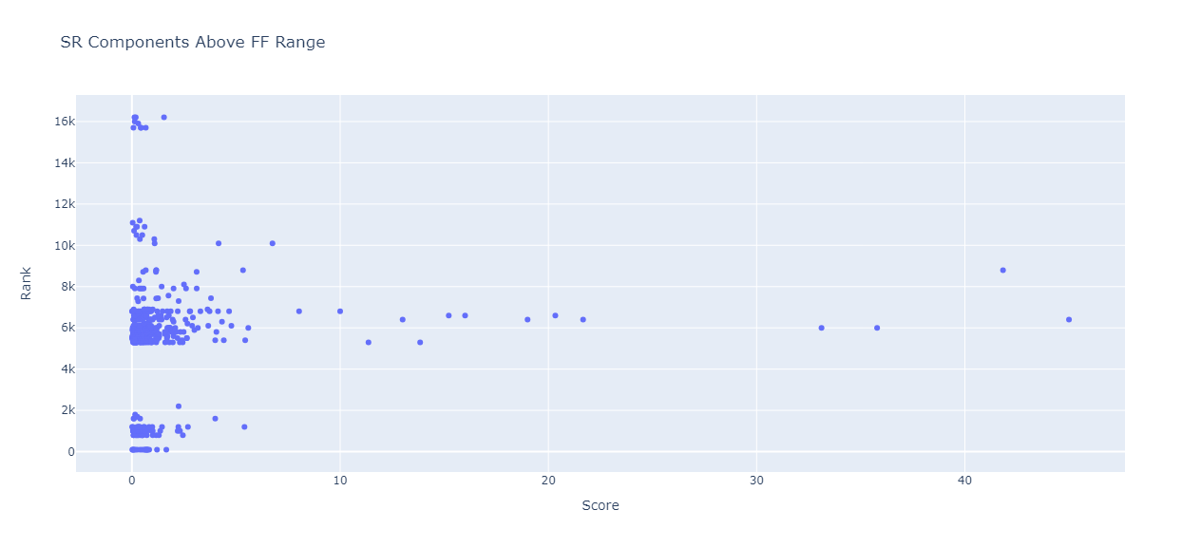
UNITED STATES NAVAL ACADEMY

Slide 7
Flagged Food Categories
Dairy/Egg
Legumes
Vegetables
UNITED STATES NAVAL ACADEMY

Slide 8
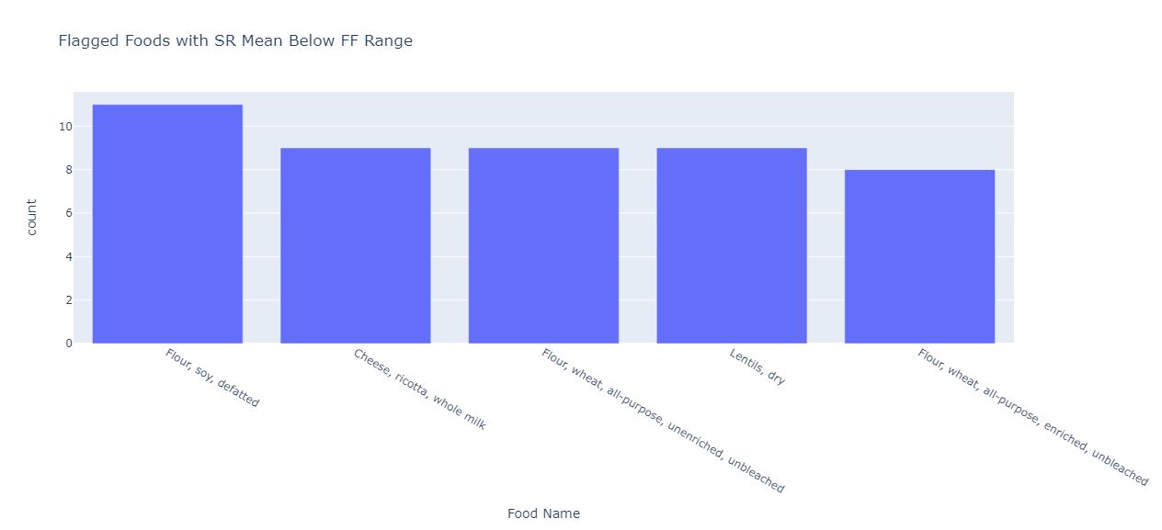
UNITED STATES NAVAL ACADEMY

Slide 9
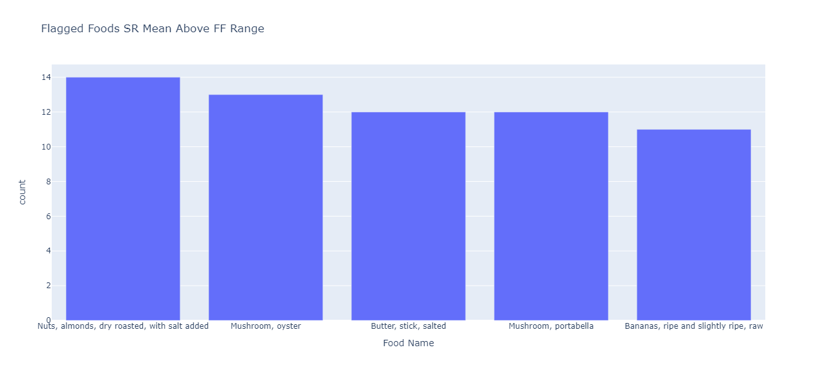
UNITED STATES NAVAL ACADEMY

Slide 10
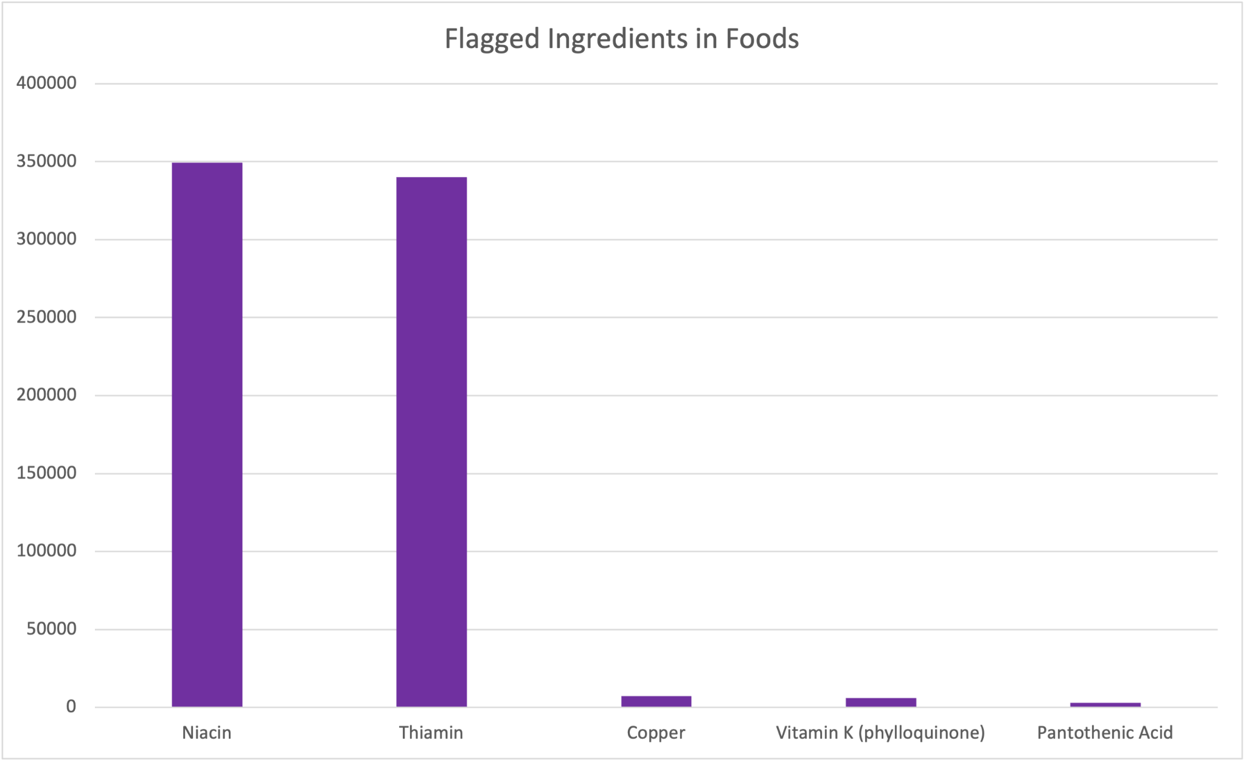
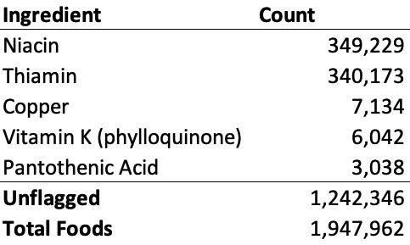
BRANDED FOODS
We took those ingredients outside the “norm” and ran a search on the USDA FDC’s Branded Foods dataset.
At least one third of USDA FDC tracked branded foods came back having at least one of the “high risk” ingredients.
UNITED STATES NAVAL ACADEMY

Slide 11
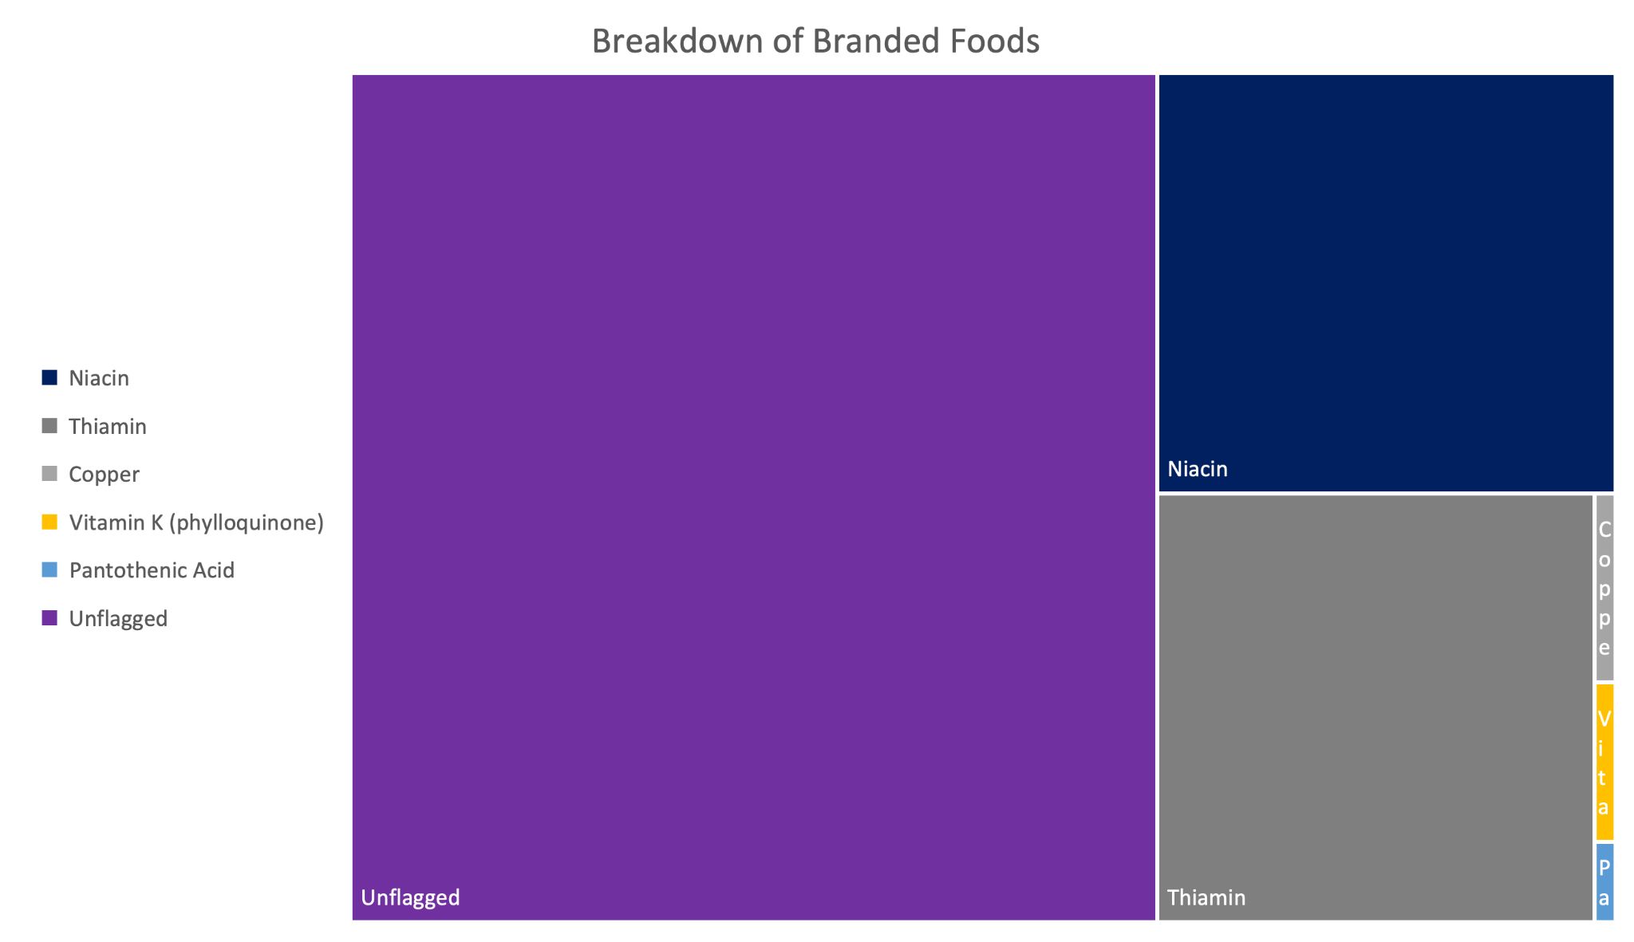
THE BREAKDOWN OF BRANDED FOOD
UNITED STATES NAVAL ACADEMY

Slide 12
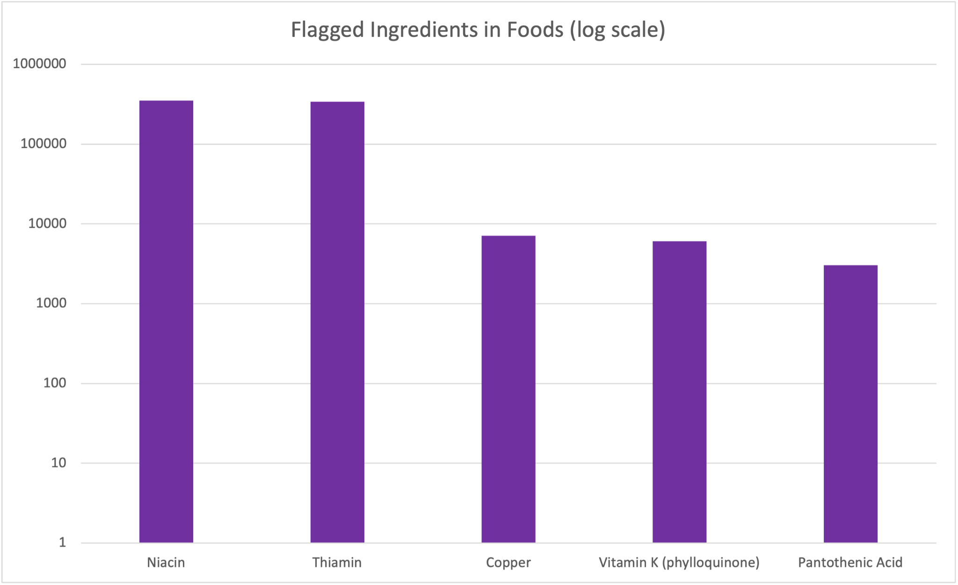

Slide 13


CONCLUSION
We believe that USDA FDC should target their analysis towards foods containing niacin and thiamin as these nutrients tend to show varied testing results over time. A targeted analysis of the these nutrients would greatly reduce the money spent on analysis of nutrient content in food.
UNITED STATES NAVAL ACADEMY

Slide 14
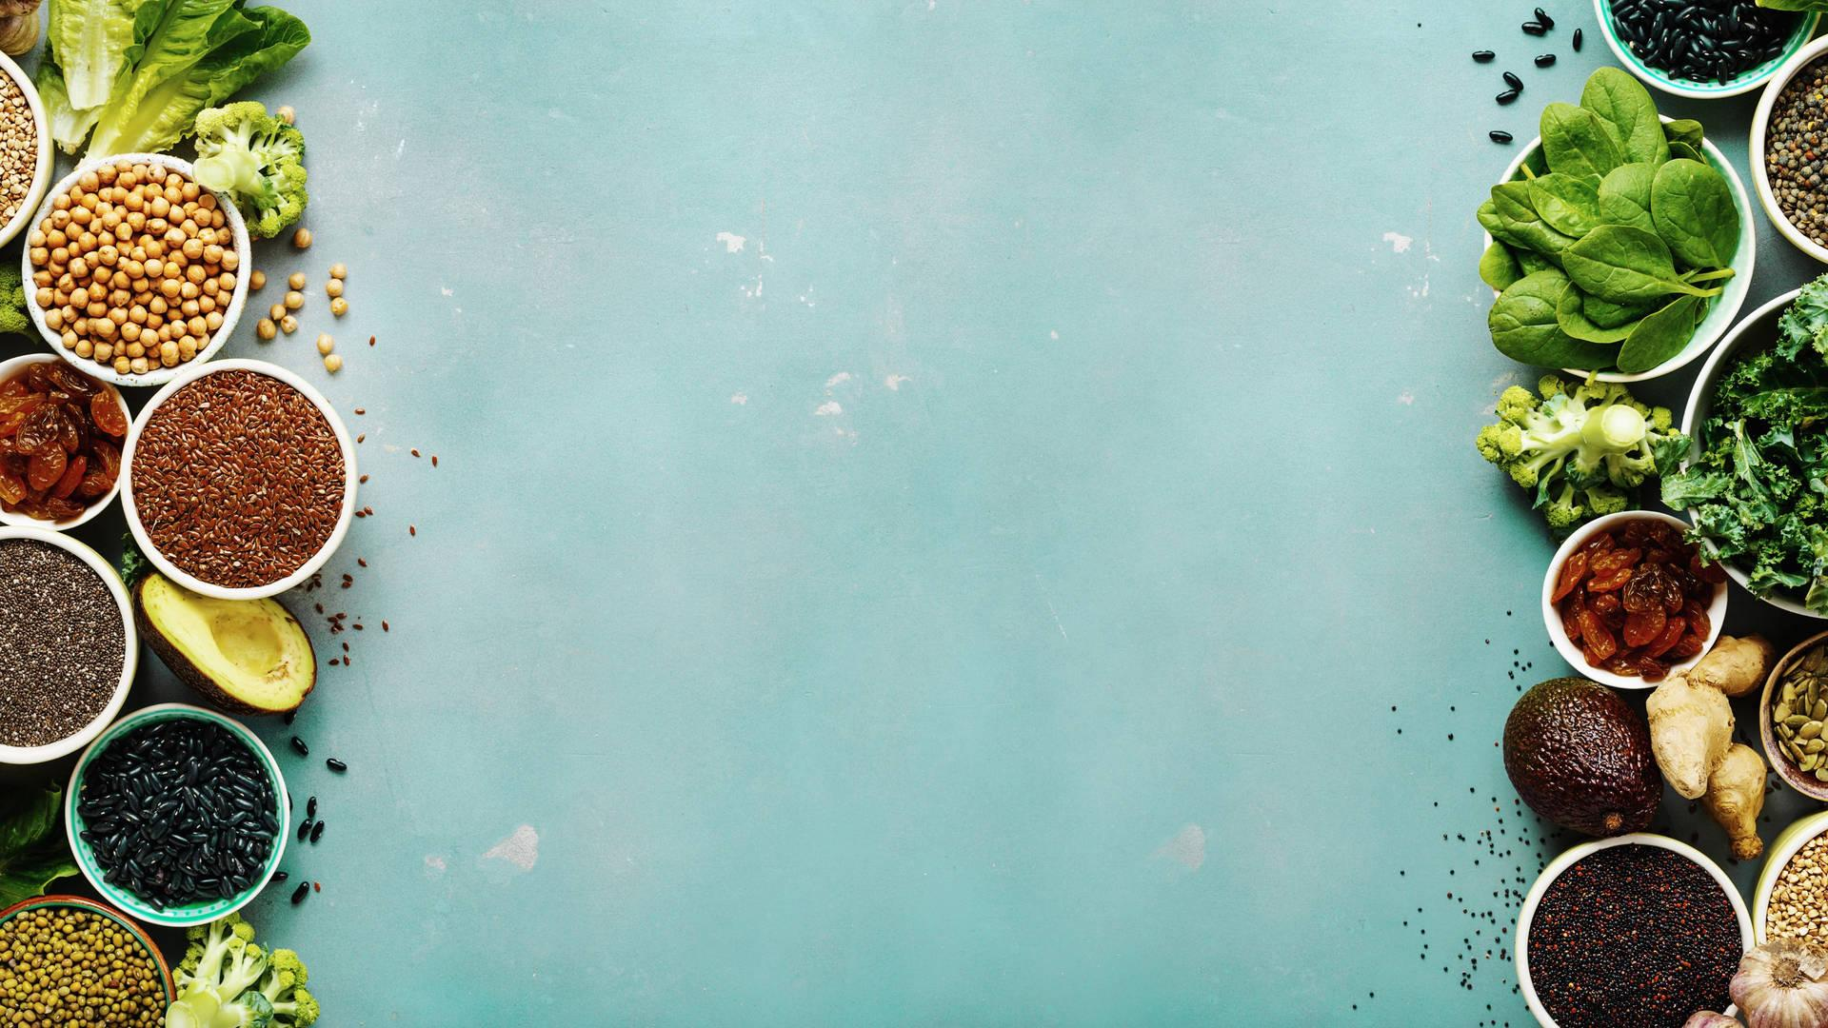

QUESTIONS?
UNITED STATES NAVAL ACADEMY

